Slide 1
Drafting, Revising, & Editing
The Writing Process

Slide 2
Prewriting Review
Annotating Text
Listing
Brainstorming
Journaling
Questioning
Freewriting
The first step in the Writing Process

Slide 3
Drafting
Write down a few strong ideas from the prewriting stage
Why do you like them? Or hate them?
How convincing are the ideas?
What evidence can you find to support them?
Rearrange the ideas into some kind of outline
Start writing without worrying about spelling and/or punctuation
What ideas emerge?
How much sense do they make?

Slide 5
Revising a Draft
Reread and revise your draft
What will the A think of my argument?
Do any words need to be defined?
Are my points clear?
Check grammar, spelling, and punctuation (be an editor)
Can you see your own writing critically?
Ask another person to read your draft and consider the advice
Read the almost-final draft out loud to yourself
Reread and revise again and again

Slide 6
Coordinating Conjunctions
Sentence-Combining: IC, BOYFANS ic.
Conjunctions join two independent clauses.
A comma (,) always precedes the conjunction.

Slide 7
BOYFANS
But
Or
Yet
For
And
Nor
So

Slide 8
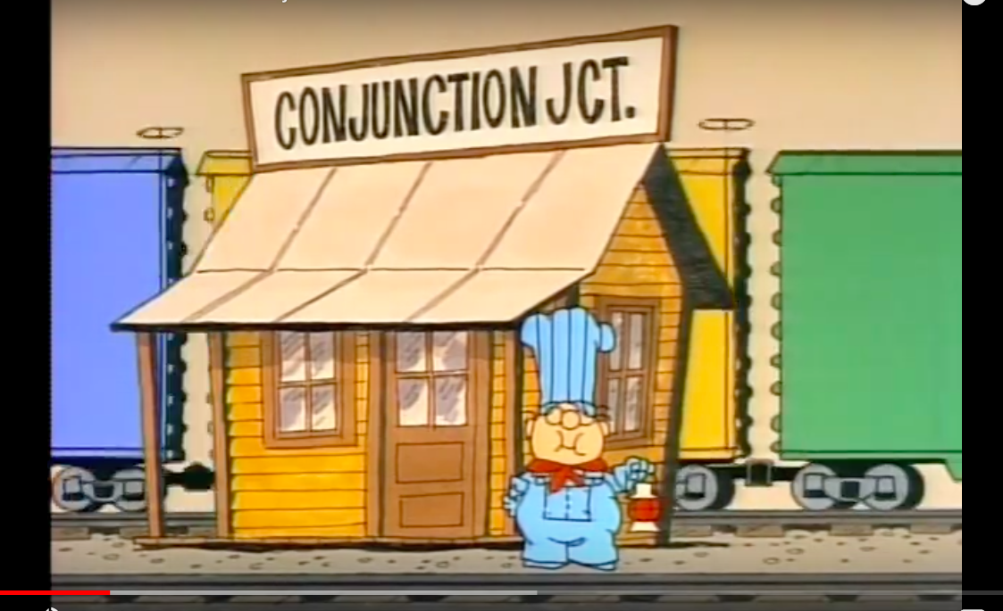

Slide 9
Combining Sentences with Conjunctions
The girls and boys are eating. They are listening to music.
The water is hot. Zain is going to wait until it cools off.
He likes eating meat. He prefers fruits and vegetables.
Khalid is singing. His voice is not very good.
Most students like to shop. They also like to eat in restaurants.
We can go to the gym. We could go to the mall.

Slide 10
Quiz Review
Sentence
IC
Preposition
Sentence-Combining
IC; ic.
IC, BOYFANS ic.
Audience
Purpose

